Slide 1

ASSESSMENT OF THE EFFECT OF ARTISANAL AND SMALL-SCALE MINING ON HOUSEHOLD INCOME LEVELS IN RURAL MALAWI: A CASE OF DOWA DISTRICT MINERS
MBA Thesis Defence
GERALD MVULA
ESAMI BUSINESS SCHOOL, ARUSHA, TANZANIA

Slide 2
PRESENTATION OUTLINE
Introduction
Problem statement
Research Objectives
Research Questions and/or Propositions and/or Hypotheses
Conceptual framework
Research Design/Methodology
Results/Findings
Conclusion
Recommendations

Slide 3
Introduction
Artisanal and small-scale mining (ASM) is one of the emerging businesses in developing countries, enabling economic diversification for people abandoning rural areas where most mining activities take place
Between 40 – 50 million people across the world are said to depend on artisan and small-scale- scale mining (ASM). According to Hilson et al. (2018) primary source of income, which accounts for 150 million, is indirectly impacted by industries.
Mining has long been regarded as one of Africa's most significant economic activities. The continent has made substantial contributions to manufacturing by providing high-value minerals to the rest of the world.
According to Haundi et al. (2021), minerals extracted in Malawi have various marketing arrangements based on their type. Commercialized commodities, such as coal, are typically sold locally to the manufacturing industry as a source of energy.

Slide 4
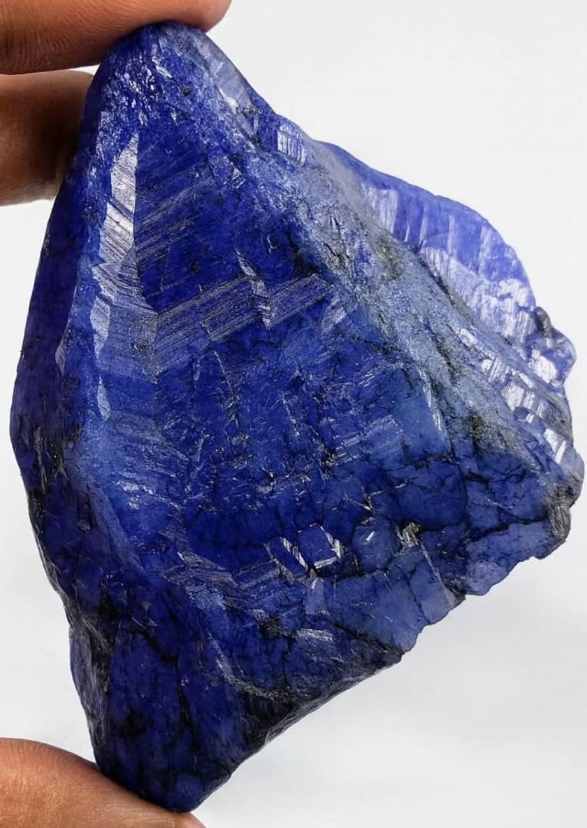
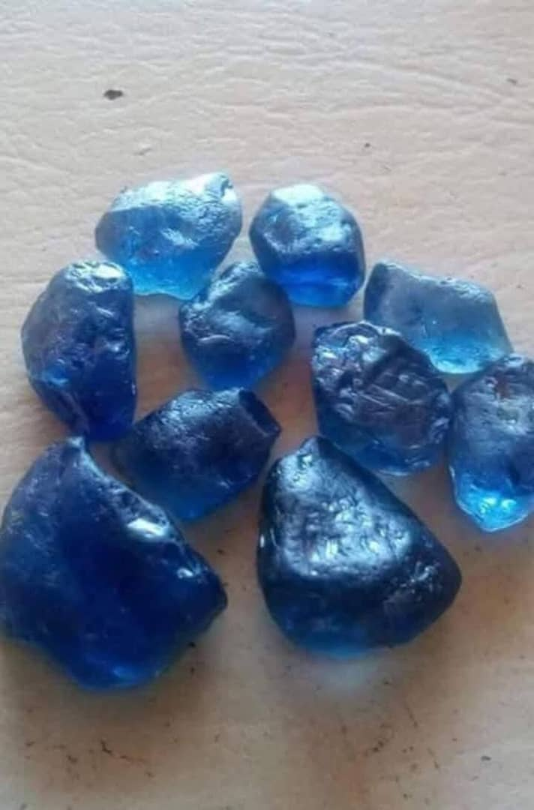
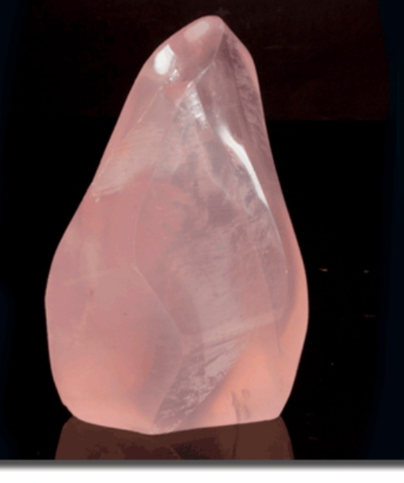

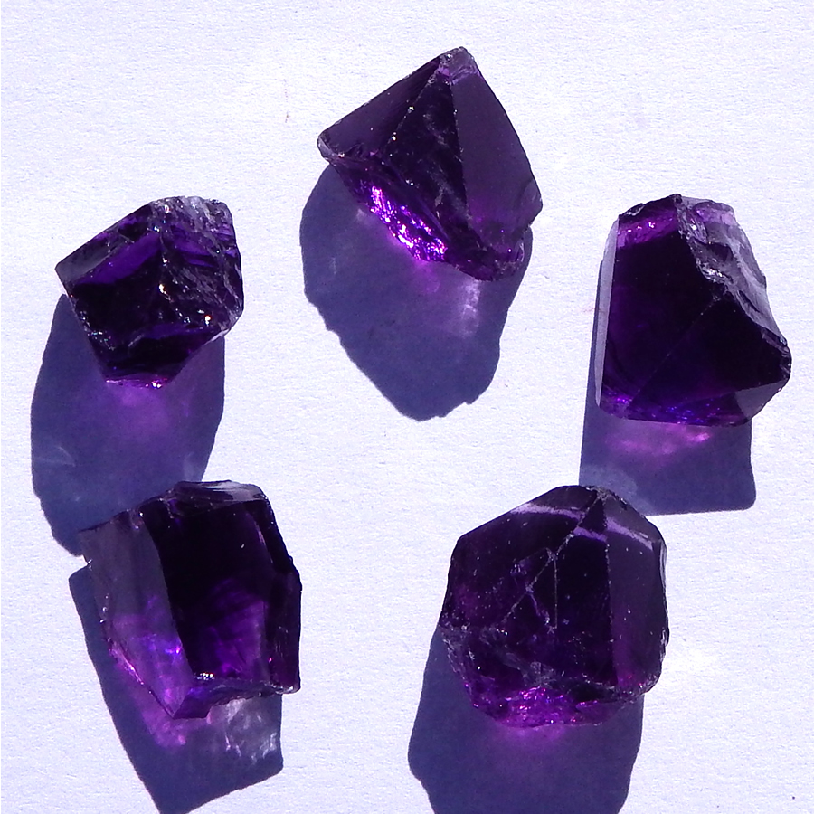


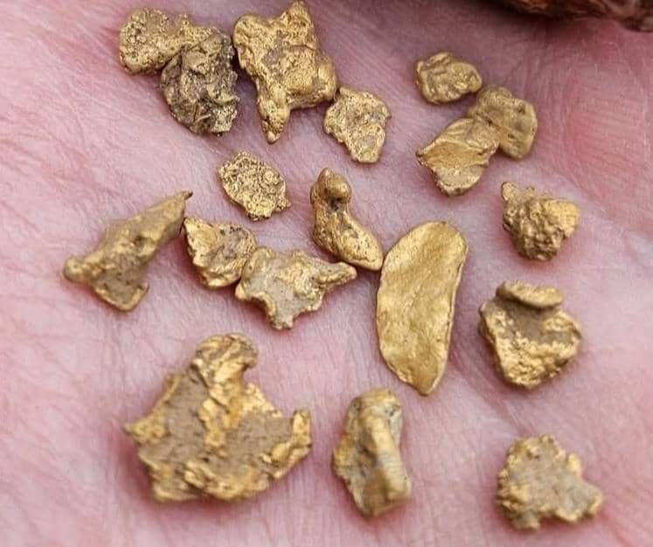
Minerals Mined Using ASM

Slide 5
Problem Statement
Although most African governments lack detailed information on production volumes, value chains, and multiplier effects, studies from Ghana and Tanzania show that, with the right support, ASM can create two to three times the local economic value of agriculture in mineral-rich areas (Mkodzongi & Spiegel, 2019).
There are gaps in the literature regarding the effects that artisanal and small-scale mining activities "have had" or "will most likely have" on the livelihoods of farmers who have become miners, particularly as Malawi works to promote its mining industry (Kenneth, 2016).
Therefore, the purpose of the study was to determine how ASM affected livelihoods in the Dowa district of central Malawi. Additionally, it looks at Malawi's mining regulations and how they affect ASM. The livelihoods approach focuses on the socioeconomic factors of miners.

Slide 6
Study Objectives
Main Objective: The main objective of the study was to assess the effect of small-scale and artisanal mining on Dowa district household income levels, focusing on rural Malawi.
Specific Objectives
To evaluate the relationship between household income levels among artisanal miners in Dowa District and their level of ASM membership (full-time vs. part-time).
To examine how the scale of ASM operation (individual, group, or small-scale commercial) affects household income levels among miners in Dowa District.
To assess the levels, patterns, and sources of household income among artisanal and small-scale mining (ASM) households in Dowa District, Malawi.
To investigate the effect of access to finance on the relationship between ASM participation and household income levels among mining households.

Slide 7
Main question: What is the impact of artisanal and small-scale mining on household income levels in Dowa District, Malawi?
Research Question
Research Question
What is the effect of the level of ASM participation on household income levels?
What is the relationship between the scale of ASM operation and household income levels?
What are the levels, patterns, and main sources of household income among ASM households in Dowa District?
How does access to finance moderate the relationship between ASM participation and household income levels?

Slide 8
Hypothesis
Based on the research questions and objectives, the study tested the following hypotheses, indicated from Null Hypothesis 1 to 4 and Alternative Hypothesis 1 to 4:
Null Hypothesis 1 (H1₀): There is no significant difference in household income levels between full-time and part-time ASM participants.
Alternative Hypothesis 1 (H1₁): Full-time ASM participants have significantly higher household income levels than part-time participants.
Null Hypothesis 2 (H2₀): There is no significant relationship between the scale of ASM operation and household income levels.
Alternative Hypothesis 2 (H2₁): Larger-scale ASM operations are associated with significantly higher household income levels.
Null Hypothesis 3 (H3₀): There is no significant variation in household income levels among ASM households in Dowa District based on income source or activity pattern.
Alternative Hypothesis 3 (H3₁): There is significant variation in household income levels among ASM households in Dowa District based on income source or activity pattern.
Null Hypothesis 4 (H4₀): There is no significant relationship between household income levels and ASM participation.
Alternative Hypothesis 4 (H4₁): There is a significant relationship between financial household income levels and ASM participation.

Slide 9
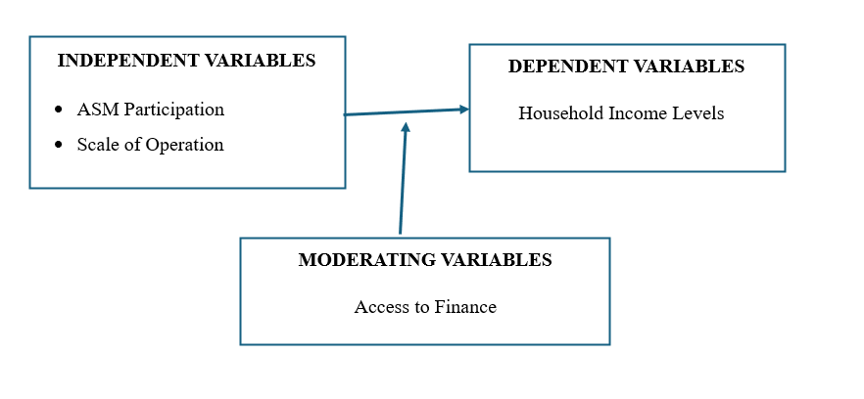
Conceptual framework
This study explores how artisanal and small-scale mining (ASM) affects household income in Dowa District. Key independent variables include ASM involvement and operational scale, which influence income through participation intensity and mining structure. Moderating variables like access to finance shape the strength of this relationship, enabling miners to invest and expand operations. The dependent variable household income captures total earnings from ASM and other sources, reflecting financial stability. Together, these variables reveal how ASM activities, resource access, and external conditions interact to determine economic outcomes for mining households.

Slide 10
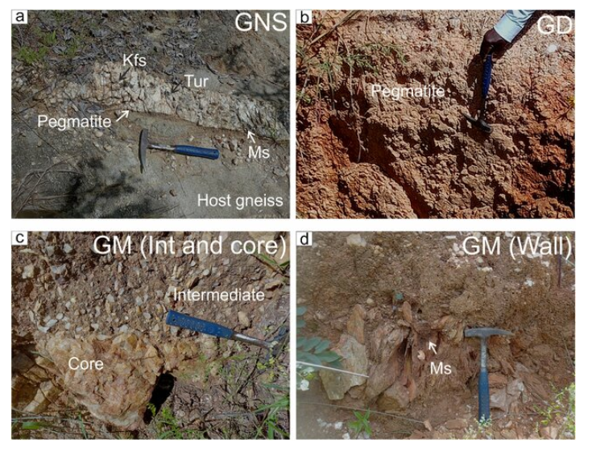
MATERIALS AND METHODS
Minerals | Location | Operator/Type
Gypsum | T/A Kayembe | Artisanal, Small Scale Miners
Galena | T/As Chiwere, Mkukula, Msakambewa | Artisanal, Small Scale Miners
Quartz | T/A Chiwere | Artisanal, Small-Scale Miners
Fluorite | T/A Chiwere | Artisanal, Small Scale Miners
Tourmaline | T/As Kayemba, Chiwere | Artisanal, Small Scale Miners
Mica | T/A Mkukula | Artisanal, Small Scale Miners
Gold | T/A Chiwere | Artisanal, Small Scale Miners

Slide 11
Research methodology
STUDY AREA
Dowa District under 4 T/A
STUDY PARTICIPANTS: participants were recruited from 4 T/As
RESEARCH DESIGN
Mixed Methods
RESEARCH PHILOSOPHY
Pragmatic
APPROACH TO THEORY DEVELOPMENT Abduction
METHODOLOGICAL CHOICE- Mixed-methods approach
RESEARCH STRATEGY –
Mixed-Methods
TIME HORIZON-
Cross-sectional

Slide 12
Continue
STUDY POPULATION -projected population of 2000 and 4 T/A in Dowa District
SAMPLING TECHNIQUE -Simple random sampling
DATA COLLECTION METHODS AND
Mixed-methods approach: Quantitative (survey) and qualitative (open ended question )
DATA ANALYSIS descriptive, inferential, regression and Thematic analysis for qualitative
RELIABILITY AND VALIDITY-pre-test the questions to 5 people
ETHICAL CONSIDERATIONS-Anonymity and confidentiality and all standers were followed
STUDY LIMITATIONS –Non-availability and unwillingness to share information by study participants
SAMPLING SIZE- 346 using Israel Formular n=(N/(1+(Ne^2))

Slide 13
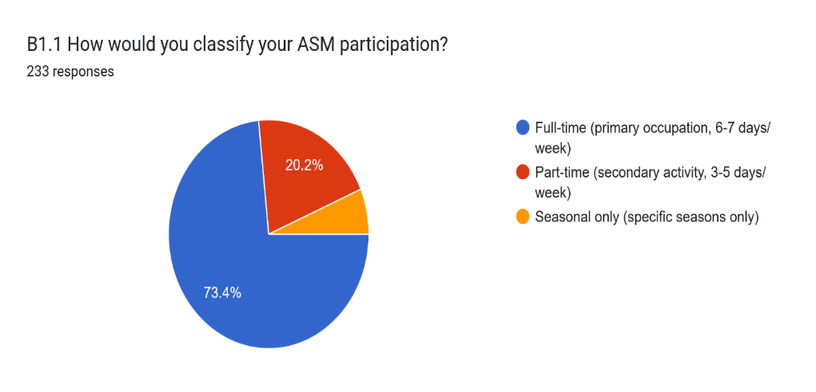
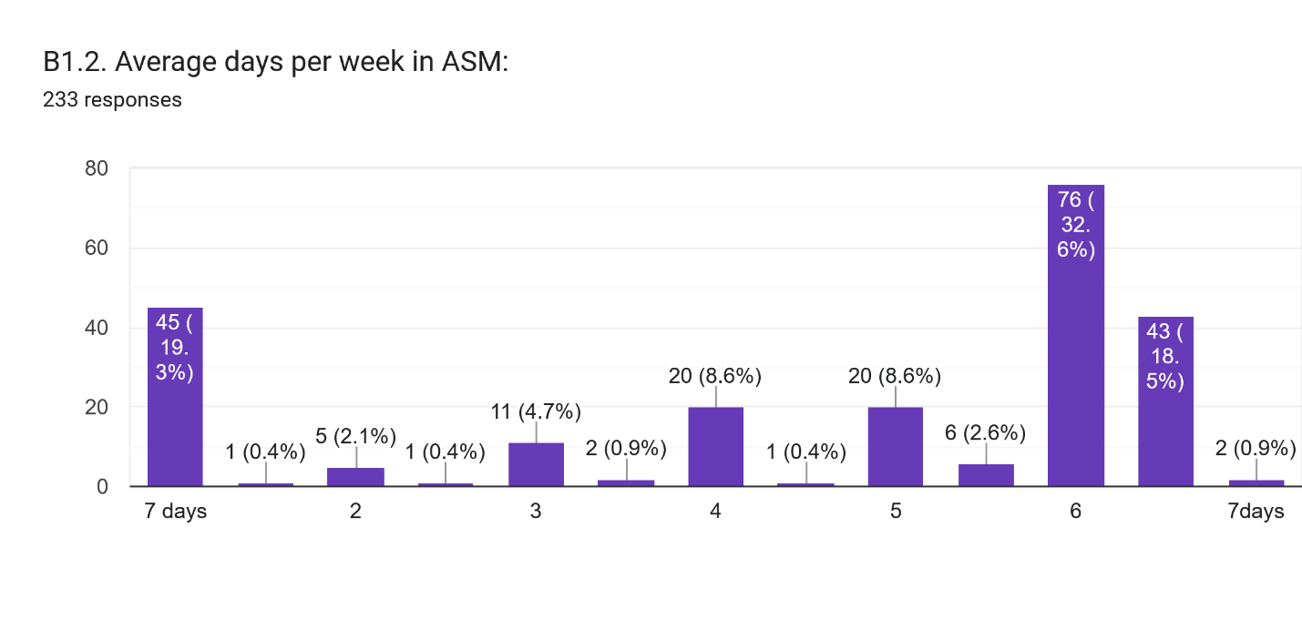
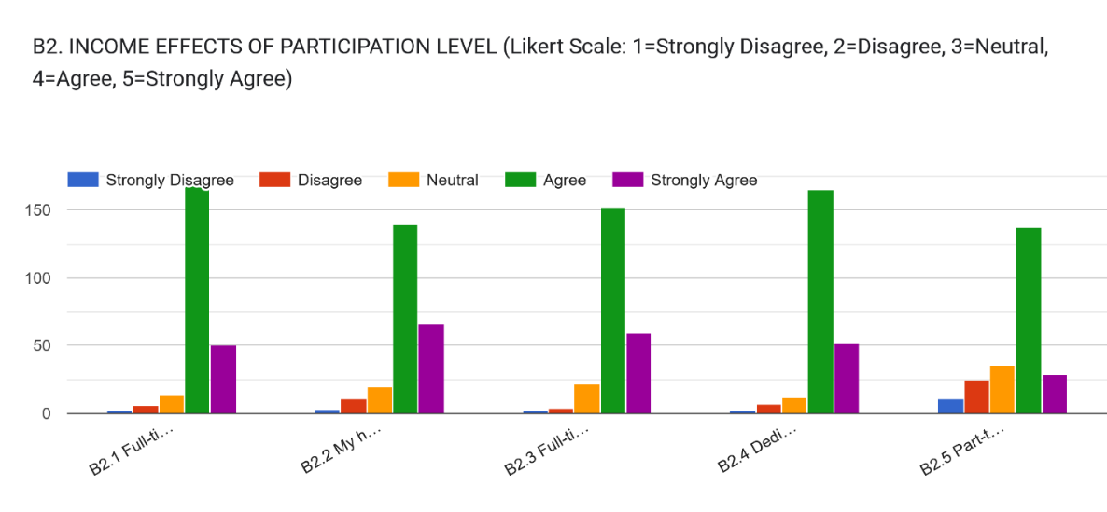
Results: Level of ASM Participation (full-time vs part-time) on Income
The findings indicate that artisanal and small-scale mining (ASM) in Dowa District is predominantly a full-time occupation, with 73.4% of respondents engaging full-time, 20.2% part-time, and 6.4% seasonally. Most miners work between six to seven days a week, highlighting ASM’s role as a primary livelihood rather than a supplementary activity. Additionally, 85% of respondents believe full-time participation increases income, confirming that consistent engagement provides superior financial benefits. These results align with studies showing ASM’s evolution into a key income source amid limited rural employment alternatives.

Slide 14
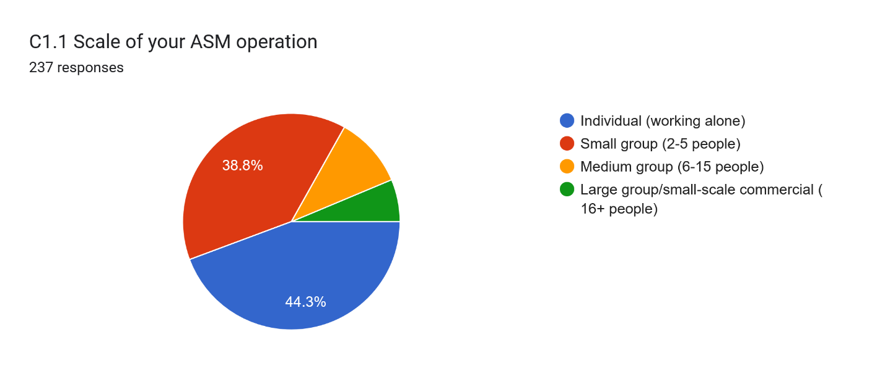
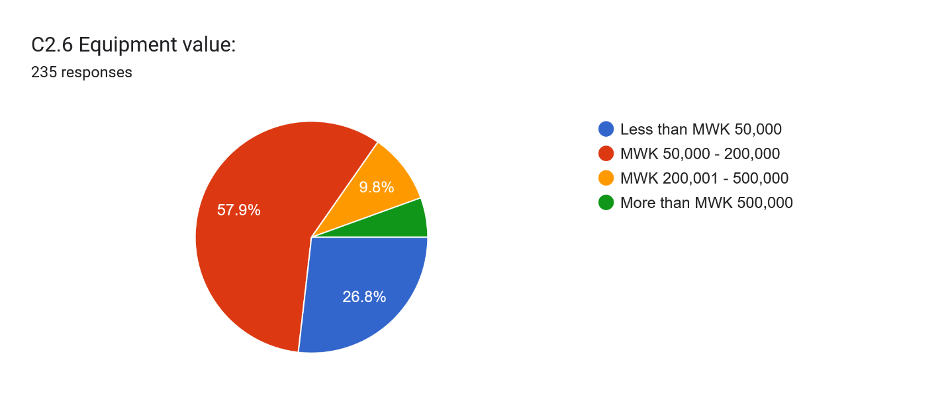
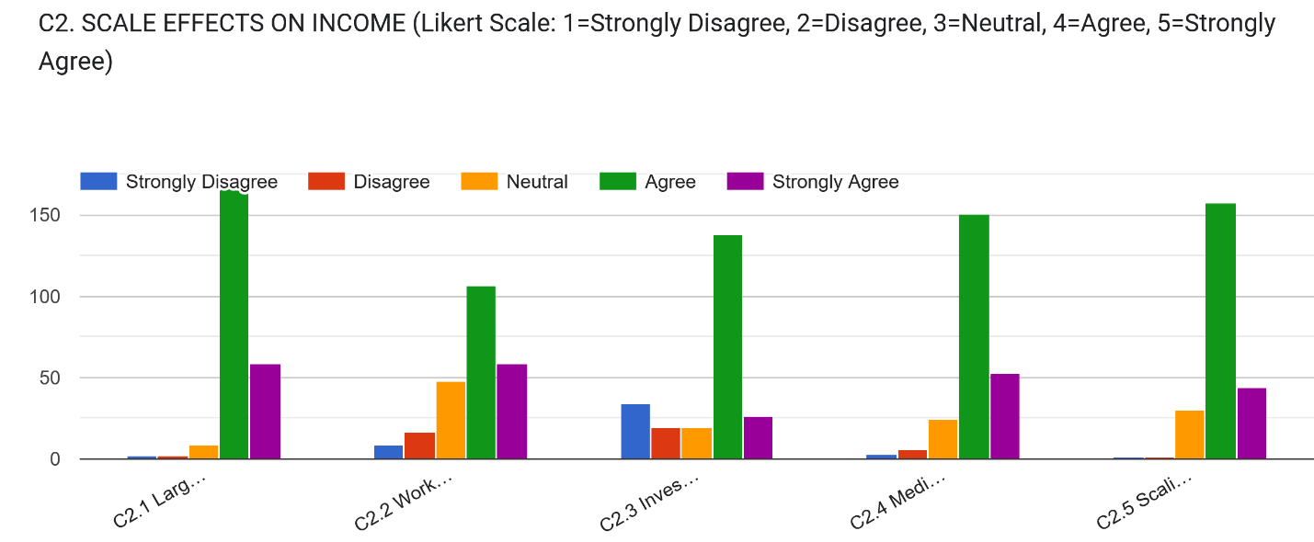
Results: Scale of ASM Operation and its Effect on Household Income
The findings reveal that artisanal and small-scale mining (ASM) in Dowa District is dominated by individual (44.3%) and small group (38.8%) operations, underscoring its micro-scale, survivalist nature. Most ventures employ fewer than four workers and process minimal material volumes, confirming ASM’s subsistence-level productivity. While 82% of respondents recognize that larger-scale operations generate higher incomes, mixed views exist on group work and equipment investments due to resource constraints. Despite aspirations for scaling up, limited capital and low-value equipment (under MWK 200,000 for 84.7%) restrict productivity and income growth potential.

Slide 15
Results: Access to Finance as A Moderator.
Thematic Analysis of Findings
Main Theme | Sub-Themes | Brief Description
1. Financial Exclusion and Limited Access | 1.1 High Financial Exclusion | 85.4% lack access to formal financial services, showing deep exclusion.
 | 1.2 Low Digital Finance Use | Only 8.8% access mobile or formal financial systems.
 | 1.3 Socioeconomic Disparities | Exclusion linked to gender, income, and education gaps.
2. Credit Constraints Among Smallholders | 2.1 Low Credit Access | 86.6% never sought loans, indicating major barriers.
 | 2.2 Minimal Repeat Borrowing | Few respondents accessed loans more than once.
 | 2.3 Need for Financial Support | Highlights need for credit, insurance, and extension services.
3. Perceptions of Financial Moderation | 3.1 Transparency in Procurement | 70% positive perception with some dissent.
 | 3.2 Accountability in Processes | Majority agree accountability exists.
 | 3.3 Fairness in Supplier Selection | Mixed views; some perceive bias or inequity.
4. Efficiency and Ethics in Procurement | 4.1 Efficiency of Procedures | 80% perceive efficient procurement systems.
 | 4.2 Ethical Standards | Positive views overall, though 20% neutral.
5. Inclusive Governance and Trust | 5.1 Need for Better Communication | Limited engagement affects inclusivity.
 | 5.2 Building Trust in Systems | Persistent skepticism reflects low institutional trust.

Slide 16
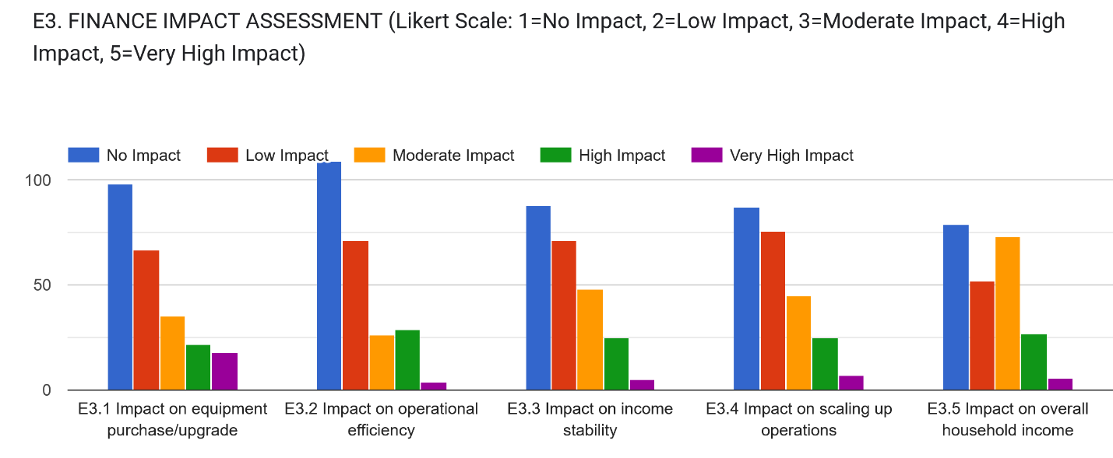
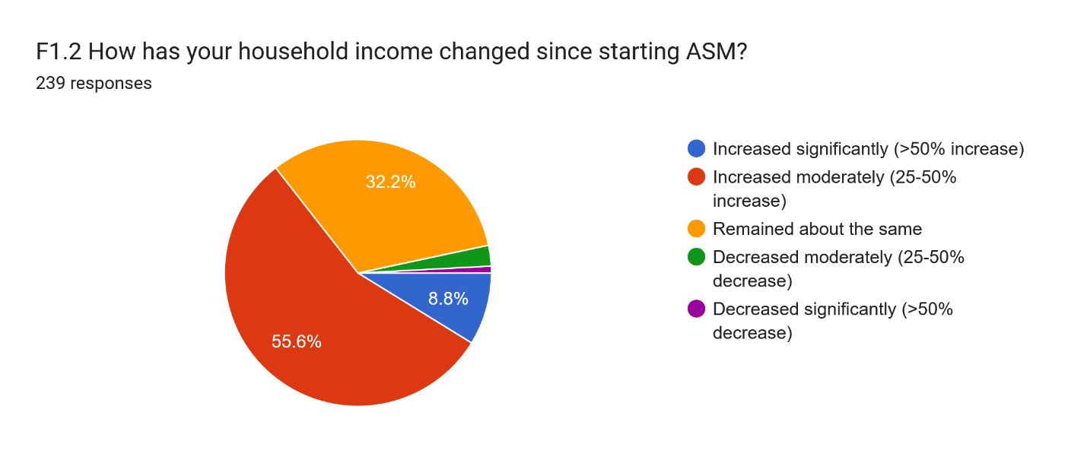
Results: Financial Impact Assessment .
The findings reveal that financial factors moderately affect equipment upgrades, operational efficiency, and income stability in ASM households, with occasional high impacts highlighting financial vulnerability. Limited access to affordable credit constrains scaling up operations and investment growth. Household income impacts vary, showing uneven financial resilience and growing inequality among miners. While most respondents report moderate income gains (25–50%) since joining ASM, others experience stagnation or decline. These results indicate that financial support and inclusive credit systems are essential to enhance stability, reduce vulnerability, and promote equitable livelihood improvements in ASM communities.

Slide 17
CONCLUSIONS
Participation–Income Link: Full-time ASM participation (73.4%) yields significantly higher household income than part-time engagement, with 85% of respondents confirming improved earnings through sustained involvement. ASM has transitioned from a supplementary to a primary livelihood source in Dowa District.
Scale–Income Relationship: Operational scale strongly influences income outcomes. Although 83.12% of miners operate individually or in small groups, 82% recognize that larger-scale operations generate higher returns. However, capital constraints 84.7% using equipment under MWK 200,000—limit growth potential.
Income Diversification and Stability: Diversified households, mainly combining ASM and agriculture (87.7%), demonstrate greater financial resilience. Sole ASM dependence heightens income volatility, with 75.7% reporting unstable earnings and only 4.6% achieving steady income levels.
Financial Access Constraints: Financial exclusion (85.4%) remains a key developmental barrier, restricting equipment investment, scaling, and income stability. Limited credit access (86.6% never sought loans) reinforces subsistence-level operations and impedes sector modernization.
Policy and Development Implications: Addressing financial exclusion, strengthening institutional credit systems, and promoting operational scaling and diversification are critical to transforming ASM from a survival mechanism into a sustainable driver of rural economic growth.

Slide 18
RECOMMENDATIONS
Strengthen ASM Policy Frameworks: Develop inclusive policies recognizing ASM as a long-term livelihood strategy, ensuring regulation, environmental compliance, and integration into national rural development agendas.
Promote Financial Inclusion: Expand access to affordable credit and mobile-based financial services tailored to ASM operations, enabling equipment investment, scaling, and income stabilization in rural mining communities.
Enhance Technical Capacity: Establish continuous training and equipment-leasing programs to modernize operations, improve productivity, and transition miners from subsistence-level to commercially sustainable mining activities.
Support Livelihood Diversification: Encourage integrated ASM–agriculture initiatives through extension services and rural enterprise programs to strengthen income stability and community resilience against mining market fluctuations.
Foster Cooperative Development: Facilitate ASM cooperative formation to enhance collective bargaining power, enable group lending access, and strengthen market linkages for improved profitability and sustainability.

Slide 19
References
Kamlongera, P., & Hilson, G. (2021). Artisanal and small-scale mining and rural livelihoods in Malawi: Opportunities and challenges. Resources Policy, 70, 101876. https://doi.org/10.1016/j.resourpol.2020.101876
Kothari, C. R. (2004). Research methodology: Methods and techniques (2nd ed.). New Age International Publishers.
Lahiri-Dutt, K. (2018). Between the plough and the pick: Informal, artisanal and small-scale mining in the contemporary world. ANU Press. https://doi.org/10.22459/BPP.03.2018
Maconachie, R., & Hilson, G. (2020). Artisanal and small-scale mining and rural livelihood diversification: The case of gold mining in Sierra Leone. Journal of Rural Studies, 77, 165-175. https://doi.org/10.1016/j.jrurstud.2020.05.005
Mkodzongi, G. (2020). Artisanal gold mining and rural livelihoods in Zimbabwe: A case study of Gwanda district. Extractive Industries and Society, 7(3), 956-964. https://doi.org/10.1016/j.exis.2020.06.011
Sippl, K. (2020). The Minamata Convention and artisanal and small-scale mining: Addressing mercury pollution. Environmental Politics, 29(6), 1033-1053. https://doi.org/10.1080/09644016.2019.1661487
Tychsen, J., Mwakumanya, M., & Maghenda, M. (2018). Artisanal and small-scale mining in Malawi: A review of policy and practice. Geological Society of London, Special Publications, 478(1), 145-160. https://doi.org/10.1144/SP478.8

Slide 20
THANK YOU FOR YOUR ATTENTION

